Slide 1
From Education to Employment: Analysing the Factors That Drive Early Career Success
By Raphael floku ayertey

Slide 2
Introduction
In today’s competitive job market, academic qualifications alone are no longer sufficient to guarantee career success. Employers increasingly value practical experience, technical competence, soft skills, and the ability to network effectively. As a result, students are encouraged to combine strong academic performance with internships, projects, certifications, and personal skill development to improve their employability and long-term career outcomes.
This project seeks to examine how students’ academic achievements, practical experience, and soft skills contribute to their early career success. By analysing real world data that includes educational background, skill levels, and employment outcomes, the study provides insight into the key factors that influence job opportunities, salary levels, career satisfaction, and professional growth.

Slide 3
Problem Statement
Despite increasing access to higher education, many graduates struggle to secure well-paying jobs or experience slow career progression after graduation. There is often uncertainty about which factors truly influence career success whether academic performance, internships, certifications, soft skills, or networking plays the most significant role.
Students frequently invest time and resources into improving their GPA or obtaining degrees without clear evidence of how these efforts translate into real world outcomes such as employment, salary growth, or job satisfaction. At the same time, employers emphasize skills such as communication, teamwork, and experience, which are not always reflected in academic results.
This creates a gap in understanding the relative importance of academic achievement, practical exposure, and soft skills in determining early career success. This project aims to bridge that gap by using data analysis to identify the factors that most strongly influence career outcomes.

Slide 4
Objectives of the Study
The main objective of this project is to analyse how students’ academic performance, skills, and extracurricular activities affect their career outcomes.
Specific Objectives:
To examine the relationship between academic performance (GPA, SAT scores) and career outcomes such as salary and job offers.
To analyse how internships, projects, and certifications influence employability and promotion speed.
To evaluate the impact of soft skills and networking ability on career satisfaction and job level.
To identify which factors have the strongest influence on early career success.
To use data visualization and statistical analysis to present insights clearly and effectively.

Slide 5
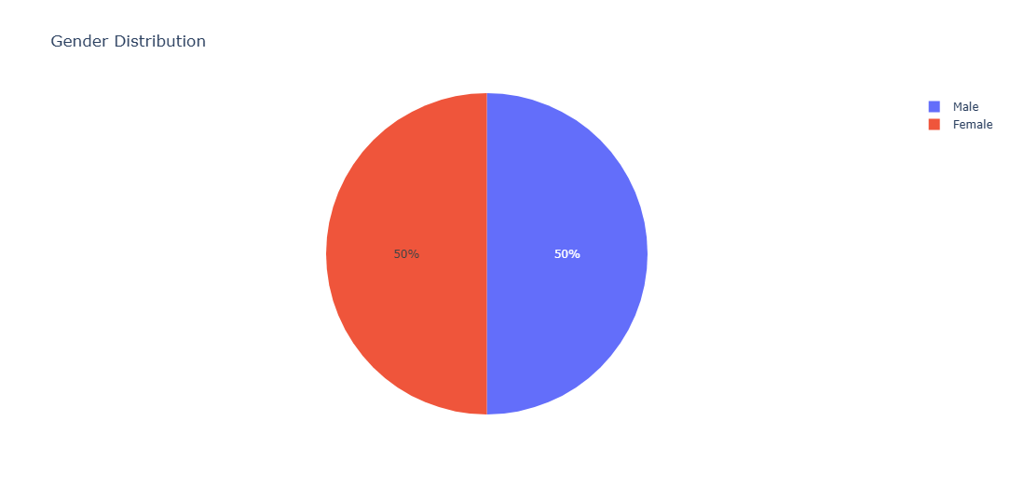
GENDER DISTRIBUTION
Equal gender distribution.

Slide 6
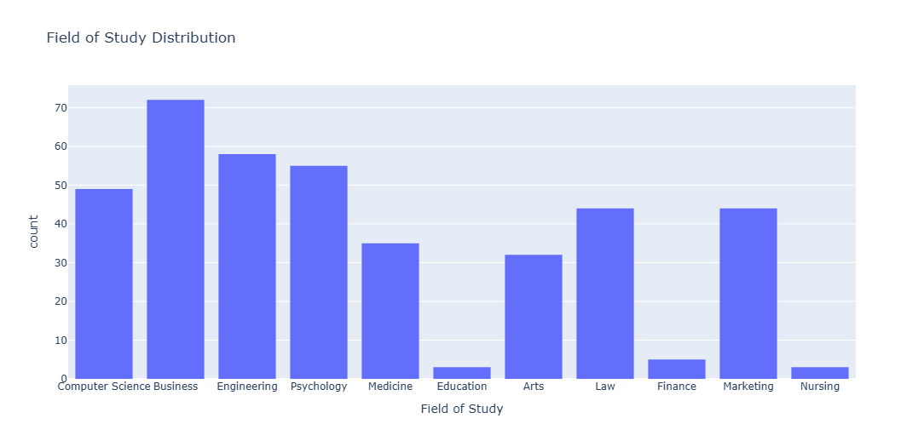
FIELD OF STUDY DISTRIBUTION
Business topped as highest number of course offered while Nursing and Education had ;same figure at the bottom.

Slide 7
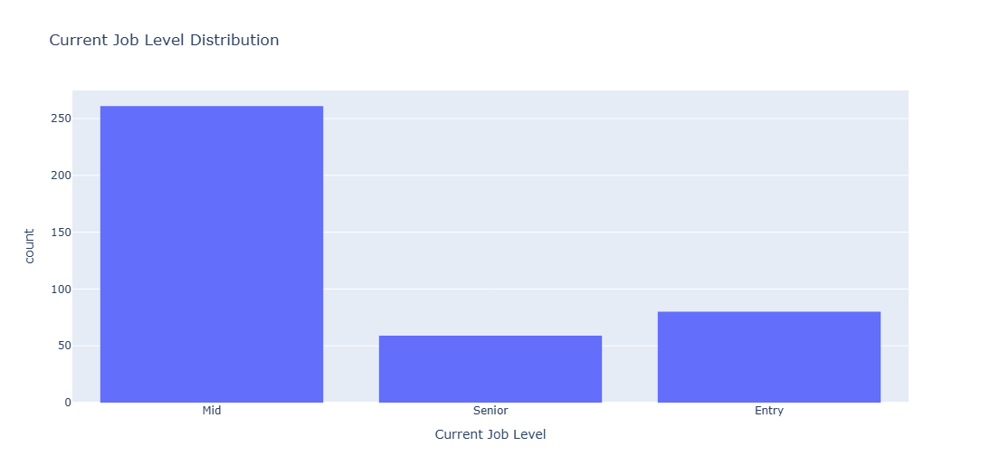
CURRENT JOB LEVEL DISTRIBUTION
Most people are at the mid level of their respective jobs.

Slide 8
ANALYSIS

Slide 9
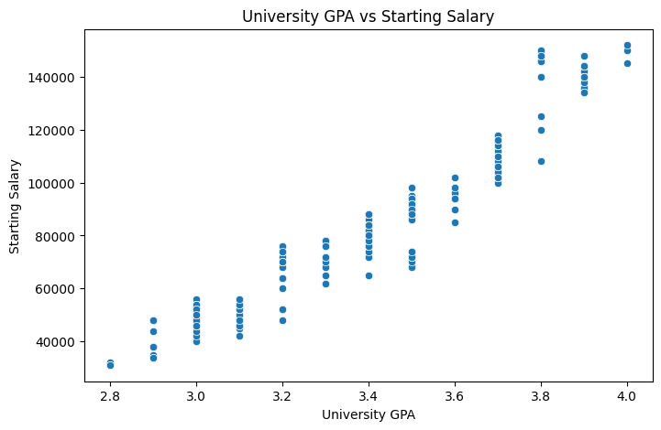
ACADEMIC PERFORMANCE(GPA) AND STARTING SALARY

Slide 10
INSIGHT ON CORRELATION BETWEEN UNIVERSITY GPA AND STARTING SALARY
The correlation coefficient of 0.956 between university GPA and starting salary indicates a very strong positive relationship. This suggests that students with higher academic performance tend to secure higher-paying jobs after graduation. The result highlights the importance of academic excellence in influencing early career earnings, although other factors such as experience and skills also contribute to career success.

Slide 11
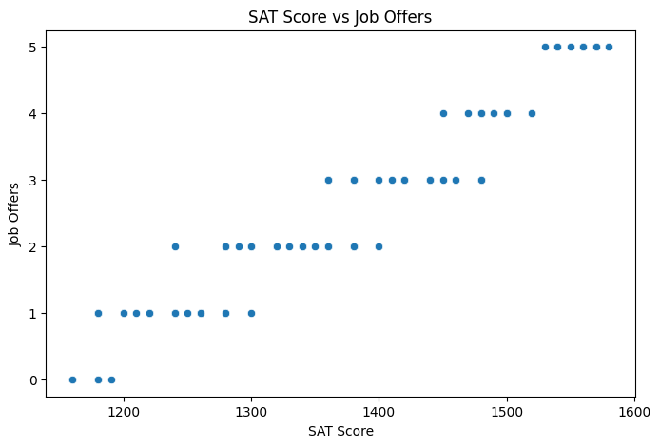
ACADEMIC PERFORMANCE(SAT) AND JOB OFFERS
Also a higher score in SAT leads to high number of job offers.

Slide 12
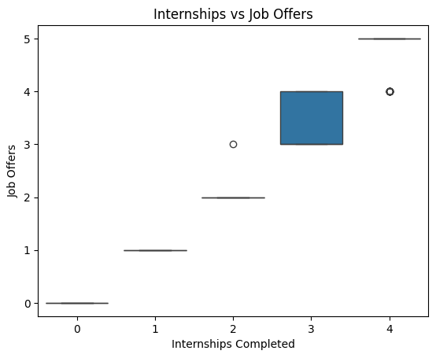
RELATIONSHIP BETWEEN INTERNSHIPS AND JOB OFFERS

Slide 13
INSIGHT ON RELATIONSHIP BETWEEN INTERNSHIPS VS JOB OFFERS
The boxplot analysis of internships completed versus job offers received indicates a very strong positive relationship, consistent with the high correlation observed in the data. This suggests that as students complete more internships, the median number of job offers they receive increases significantly and predictably. The result highlights the critical role of practical experience in enhancing a candidate's marketability, as each additional internship effectively shifts the entire distribution of job offers upward, although individual variations in interview skills and networking still influence the specific outcomes for each student.

Slide 14
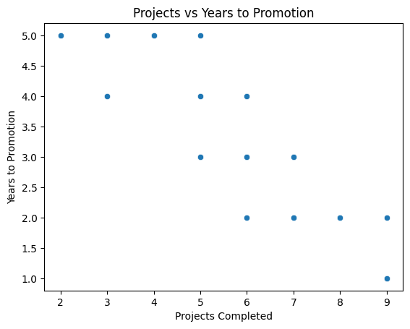
RELATIONSHIP BETWEEN PROJECTS AND YEARS TO PROMOTION

Slide 15
INISGHTS RELATIONSHIP BETWEEN PROJECTS AND YEARS TO PROMOTION
The scatterplot analysis of projects completed versus years to promotion indicates a strong negative relationship. This suggests that as students or employees complete a higher number of projects, the time required to secure a promotion tends to decrease. The result highlights the importance of tangible output and project-based experience in accelerating career advancement, although other factors such as company policy, leadership style, and specific role requirements also contribute to the speed of professional growth.

Slide 16
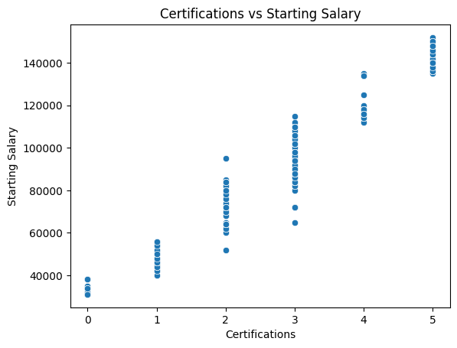
RELATIONSHIP BETWEEN CERTIFICATIONS AND SALARY

Slide 17
INSIGHT ON RELATIONSHIP BETWEEN CERTIFICATIONS AND SALARY
The scatterplot analysis of certifications versus starting salary indicates a very strong positive relationship. This suggests that students with a higher number of professional certifications tend to secure higher-paying jobs upon entering the workforce. The result highlights the importance of specialized credentials and continuous learning in influencing initial earning potential, although other factors such as university prestige, major, and internship experience also contribute to a candidate's starting compensation.

Slide 18
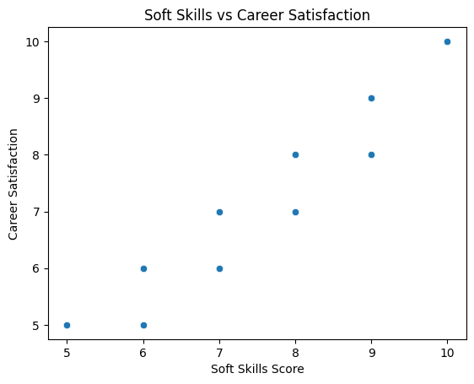
RELATIONSHIP BETWEEN SOFT SKILLS AND CAREER SATISFACTION

Slide 19
INSIGHTS ON RELATIONSHIP BETWEEN SOFT SKILLS AND CAREER SATISFACTION
The scatterplot analysis of soft skills score versus career satisfaction indicates a strong positive relationship. This suggests that individuals with higher scores in interpersonal and emotional competencies tend to report greater levels of fulfilment in their professional lives. The result highlights the significance of soft skills in influencing long-term career happiness, although other factors such as work environment, compensation, and leadership style also contribute to overall job satisfaction.

Slide 20
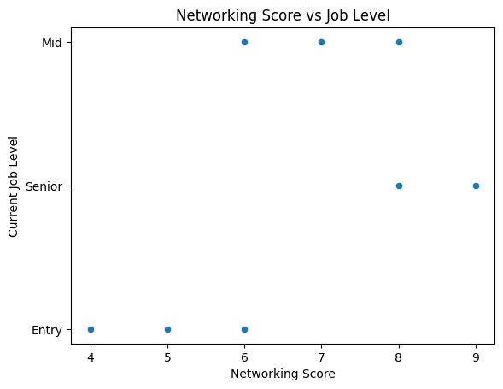
RELATIONSHIP BETWEEN NETWORKING AND JOB LEVEL

Slide 21
INSIGHT ON NETWORKING AND JOB LEVEL
The scatterplot analysis of networking score versus current job level indicates a very strong positive relationship. This suggests that individuals with higher networking scores tend to achieve higher ranking positions and advance further in their career hierarchy. The result highlights the significance of professional relationship building and networking in influencing career progression, although other factors such as technical expertise, total years of experience, and leadership abilities also contribute to an individual's current job level.

Slide 22
KEY INSIGHTS FROM THE ANALYSIS
University GPA Strongly Influences Starting Salary: The analysis revealed a very strong positive correlation between University GPA and Starting Salary. Students with higher academic performance tend to secure better-paying jobs, indicating that employers still place significant value on academic excellence when making hiring and salary decisions.
Internships Significantly Improve Employability: Students who completed more internships received more job offers and experienced faster career entry. This shows that hands-on experience plays a crucial role in making graduates job-ready and competitive in the labour market.
Projects and Certifications Support Faster Career Growth: Students with more projects and professional certifications were promoted faster and earned higher salaries. This highlights the importance of practical and industry-relevant skills beyond classroom learning.
Soft Skills Strongly Influence Career Satisfaction: A strong positive relationship was observed between soft skills and career satisfaction. Individuals with better communication, teamwork, and interpersonal skills reported higher job satisfaction and better workplace experiences.
Networking Plays a Key Role in Career Advancement: Networking score showed a strong relationship with current job level, indicating that individuals who build professional connections progress faster in their careers compared to those who rely only on academic credentials.

Slide 23
RECOMMENDATIONS
Students Should Balance Academics with Practical Experience: While GPA is important, students should actively seek internships, projects, and certifications to improve employability and career growth.
Universities Should Promote Experiential Learning: Institutions should integrate internships, project-based learning, and industry collaborations into academic programs to better prepare students for the job market.
Soft Skills Training Should Be Emphasized: Communication, teamwork, leadership, and problem-solving skills should be taught alongside technical courses to improve career satisfaction and workplace success.
Career Guidance and Networking Opportunities Should Be Strengthened: Career fairs, mentorship programs, and alumni networking sessions should be encouraged to help students build professional relationships early.
Students Should Focus on Holistic Development: Rather than focusing only on grades, students should develop a balanced profile that includes academic excellence, experience, certifications, and interpersonal skills.

Slide 24
CONCLUSION
This study demonstrates that early career success is influenced by a combination of academic performance, practical experience, and personal skills. While university GPA remains an important factor in determining starting salary, it is not the sole determinant of success. Internships, projects, certifications, and soft skills play a crucial role in improving employability, career satisfaction, and professional growth. The findings emphasize that students who actively combine education with real world experience and strong interpersonal skills are more likely to achieve better career outcomes. Therefore, a holistic approach to education one that integrates academics, skill development, and networking is essential for long-term career success.

